Slide 1
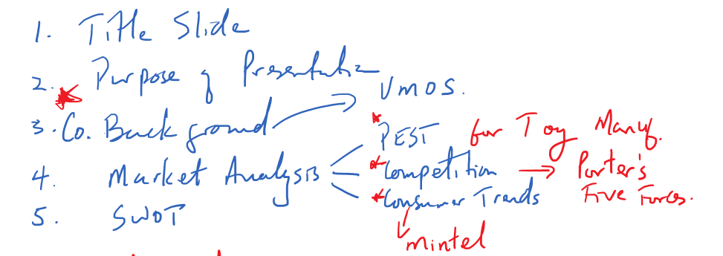
Presentation Layout and Contents

Slide 2
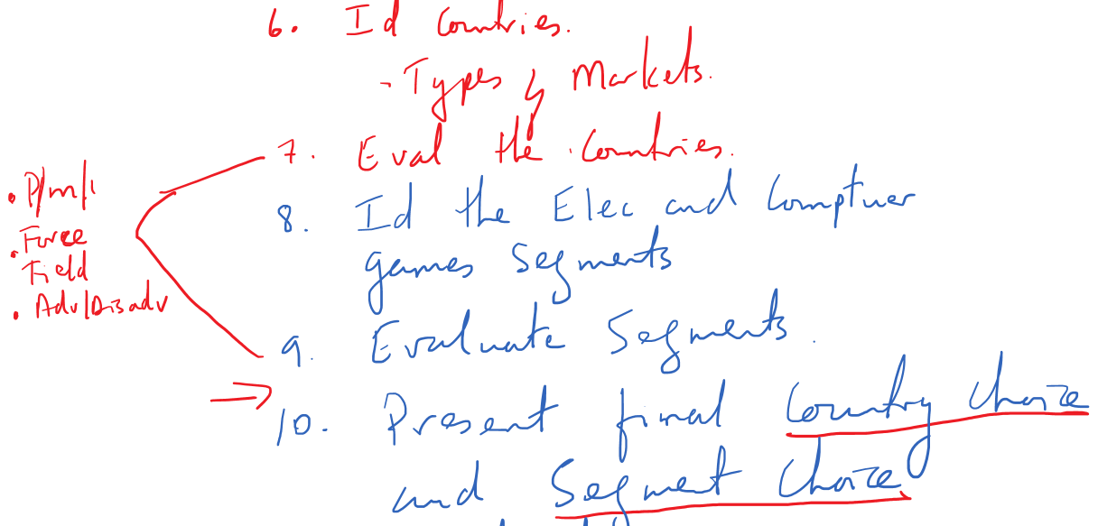

Slide 3
